Slide 1

Shiraz University
Schools of Electrical and Computer Engineering
"Face recognition using PCA and machine learning methods"
Sadegh Jamishi

Slide 2
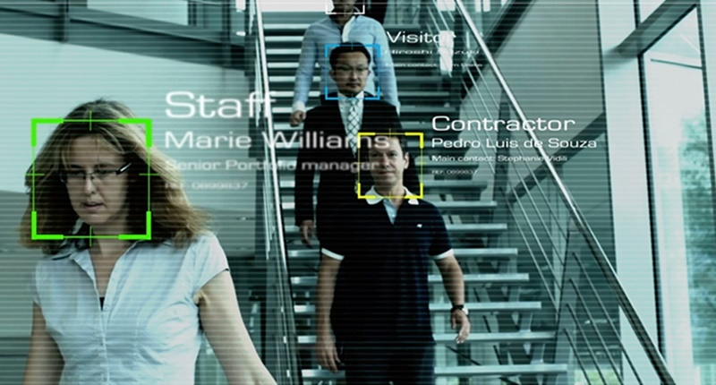
INTRODUCTION
Face recognition is one of the most important and challenging issues in the field of machine learning image processing
In order to increase the security and reliability of systems, traditional access control methods such as keys, passwords, identification cards, etc. have been replaced by face recognition.
In this paper, the design of the face recognition system is presented by combining different machine learning algorithms, and the accuracy and speed of each algorithm are examined in order to achieve a balance between accuracy and speed.

Slide 3
Background and related work
In the past, most face recognition activities focused on identifying individual features of a face, including the nose, eyes, mouth, and head, and then tried to use position, size, and the relationship between those features.
Difficult to apply these approaches in multiple views because as the size of the database increased, the accuracy of identification decreased and the equipment required increased exponentially.
Solution:
This article uses PCA-derived 'eigenface' to pinpoint each face instead of using a structural model of the face. The size of the 'eigenface' is much smaller than the original image, the computational load is reduced and the system is faster.
These images are then classified using three classification algorithms SVM, KNN and LDA and their accuracy and speed are checked.

Slide 4
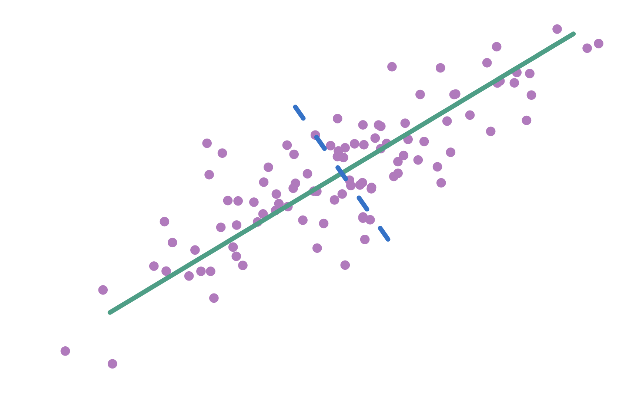
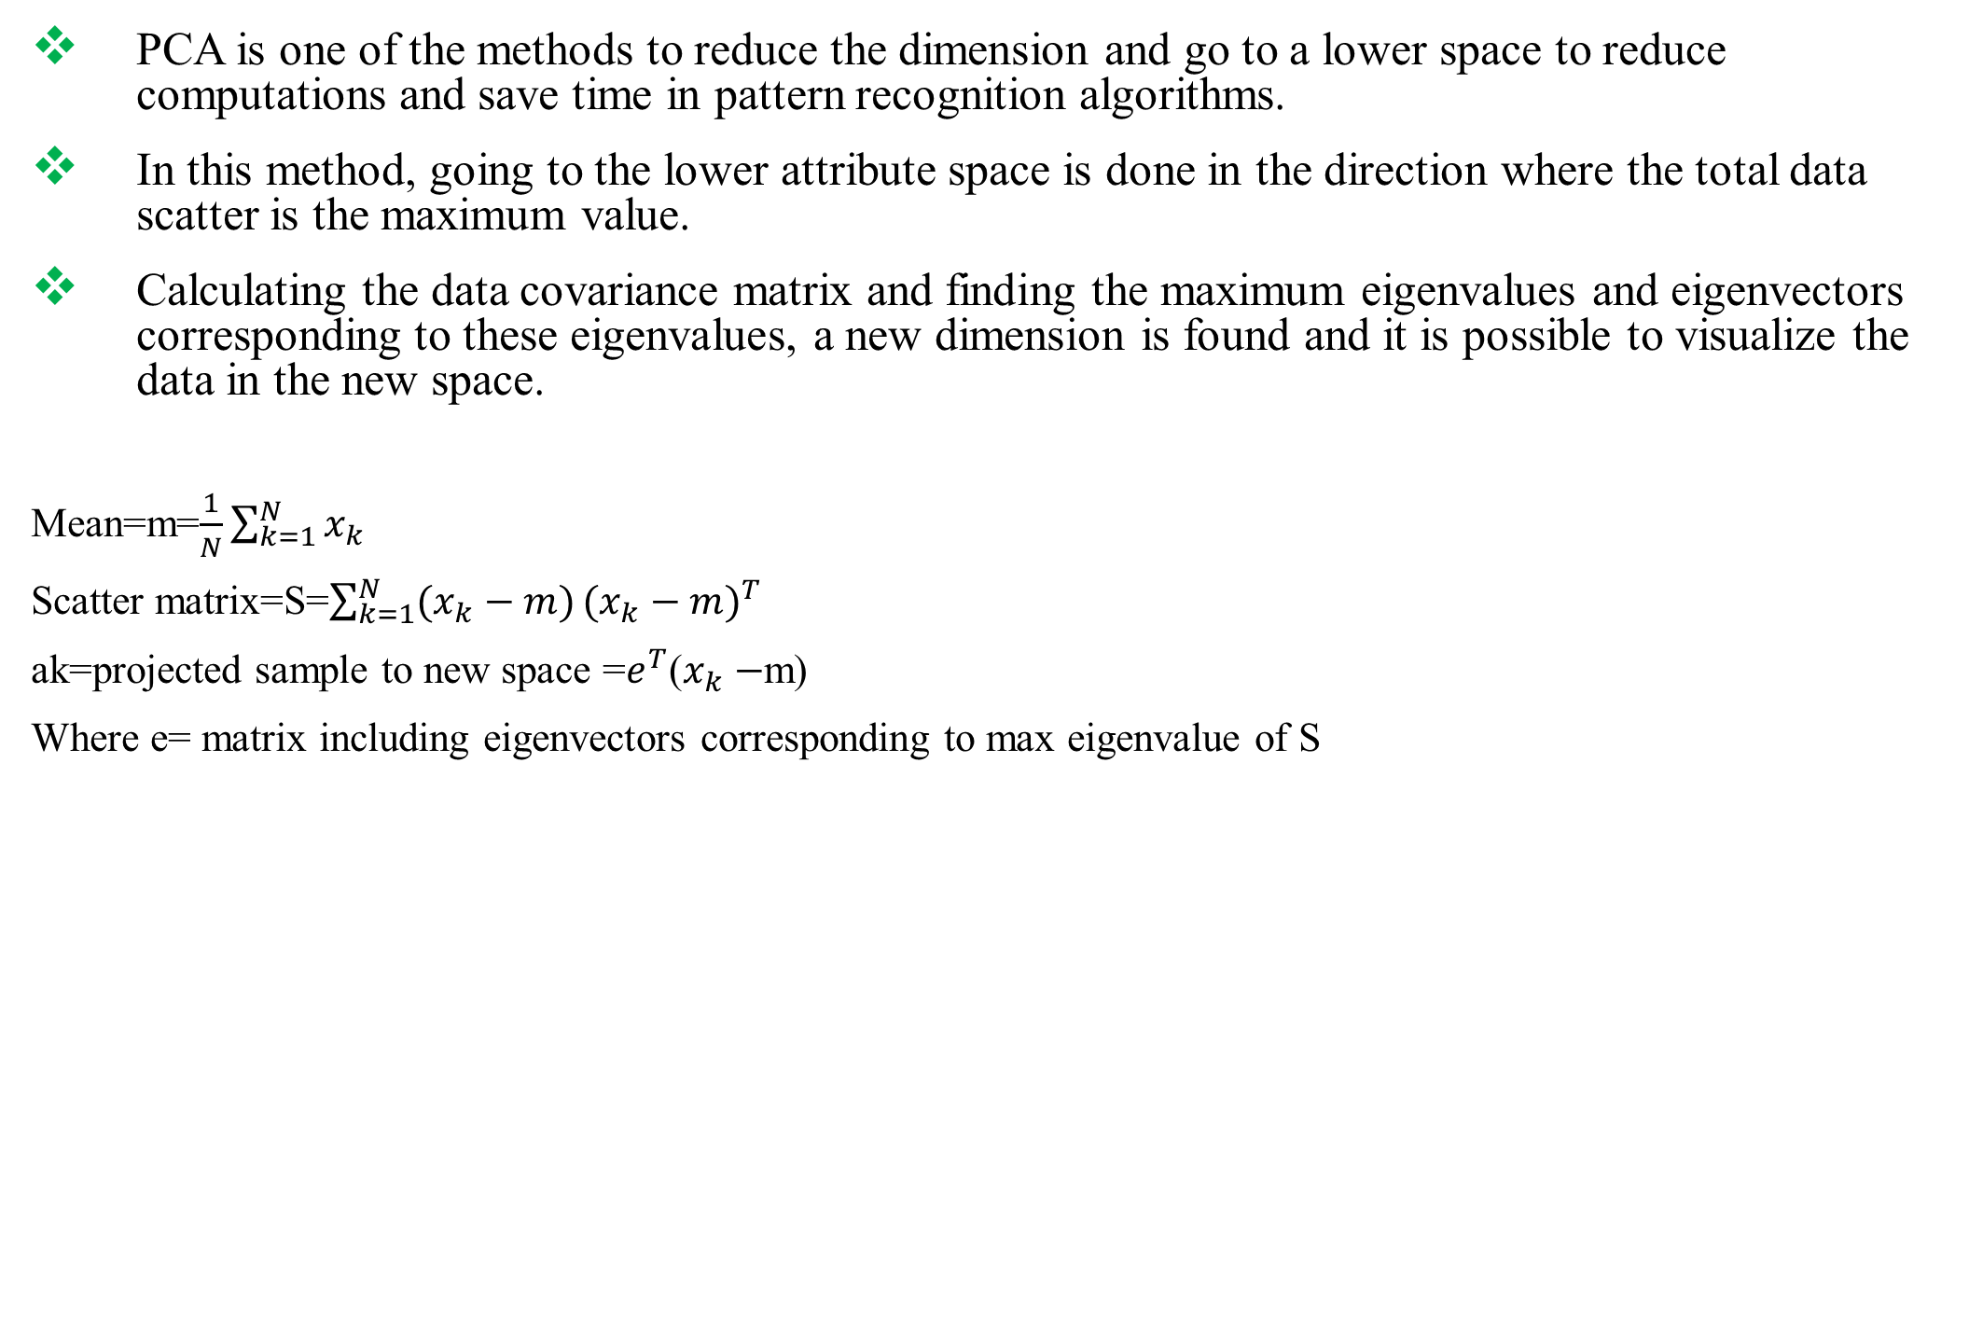
Principal Component Analysis
PCA is one of the methods to reduce the dimension and go to a lower space to reduce computations and save time in pattern recognition algorithms.
In this method, going to the lower attribute space is done in the direction where the total data scatter is the maximum value.
Calculating the data covariance matrix and finding the maximum eigenvalues and eigenvectors corresponding to these eigenvalues, a new dimension is found and it is possible to visualize the data in the new space.
Mean=m=$\frac{1}{N}\sum_{k=1}^{N}{x_{k}}$
Scatter matrix=S=$\sum_{k=1}^{N}{(x_{k}−m)}{(x_{k}−m)}^{T}$
ak=projected sample to new space =$e^{T}$($x_{k}−$m)
Where e= matrix including eigenvectors corresponding to max eigenvalue of S

Slide 5
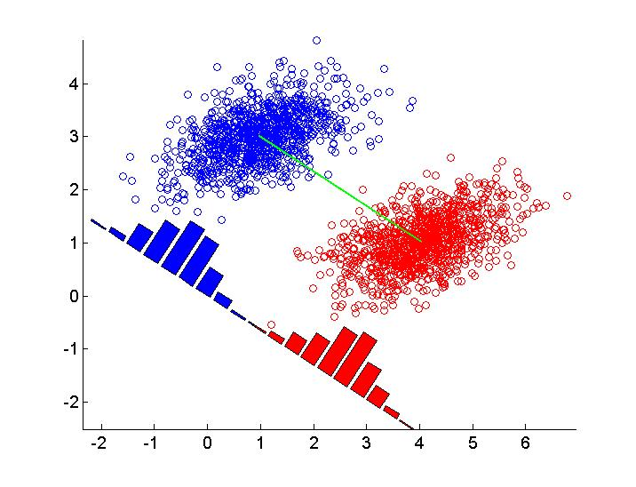
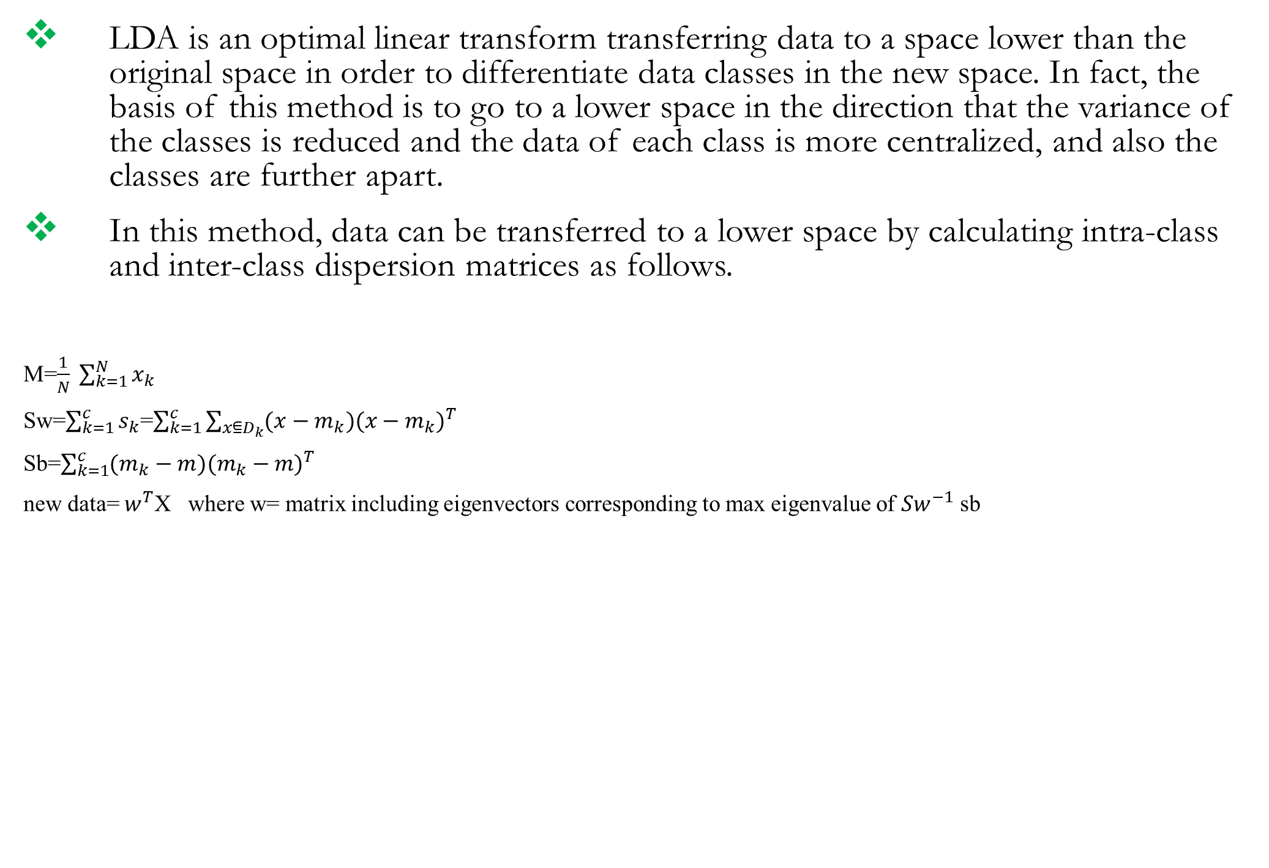
Linear Discriminant Analysis
LDA is an optimal linear transform transferring data to a space lower than the original space in order to differentiate data classes in the new space. In fact, the basis of this method is to go to a lower space in the direction that the variance of the classes is reduced and the data of each class is more centralized, and also the classes are further apart.
In this method, data can be transferred to a lower space by calculating intra-class and inter-class dispersion matrices as follows.
M=$\frac{1}{N} \sum_{k=1}^{N}{x_{k}}$
Sw=$\sum_{k=1}^{c}{s_{k}}$=$\sum_{k=1}^{c}{\sum_{x⋸D_{k}}{(x−m_{k}}){(x−m_{k})}^{T}}$
Sb=$\sum_{k=1}^{c}{(m_{k}−m){(m_{k}−m)}^{T}}$
new data= $w^{T}$X where w= matrix including eigenvectors corresponding to max eigenvalue of ${Sw}^{−1}$ sb

Slide 6
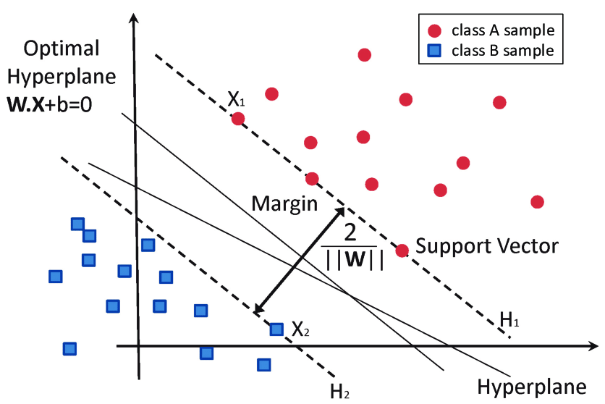
Support Vector Machine
SVM is one of the supervised data classification methods.
The basis of this method is linear classification of data with the aim of finding the line with the most reliable margin, or in other words, the most distant backup data or data that is closer to the class boundary.
The concept of SVM and backup vectors is well understood in the figure below.

Slide 7
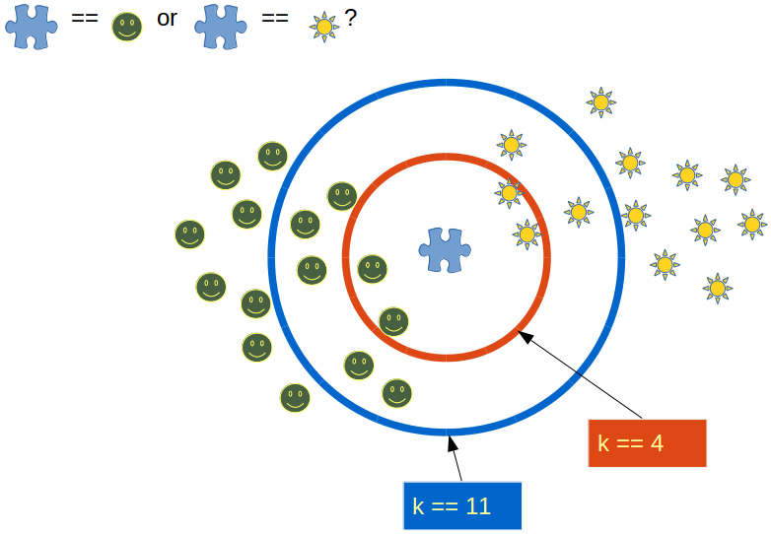
Classification by Nearest Neighbors (K Nearest Neighbor)
KNN is one of the non-parametric methods for data classification.
Depending on the value of K, find the closest available samples to the test sample. Among these points, Considering the class that has a higher percentage of data as the input data class.
If K is equal to one, the decision criterion is the nearest point. We find the nearest training data to the input sample and assign the class of that data to the class of the desired point.

Slide 8
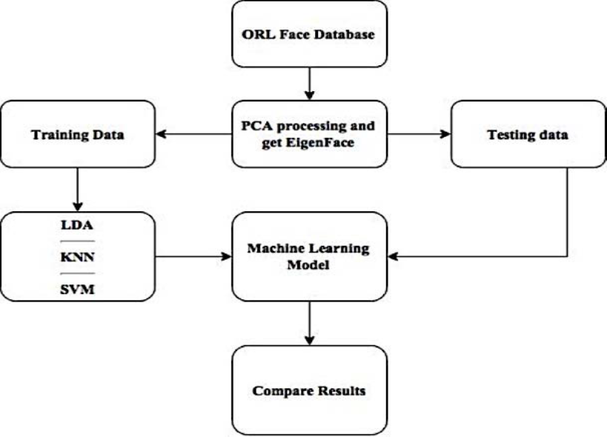
procedure
Database: In this article, we use the "ORL face database".
This set contains 400 gray images (90 x 112) of 40 different people, of which there are 10 images of each person in different situations.
Our face recognition system consists of two main parts: dimensional reduction with PCA and data classification using three SVM, KNN and LDA algorithms.
In PCA, we go to the lower space with different dimensions and examine the effect of dimension on classification accuracy.
In the classification section, we try all three of the above methods and examine the accuracy and duration of all three.

Slide 9
Effect of changing the ratio of training and test data
Dividing the data into test and training in three ways: 30, 50 and 70%.
The size of the images after PCA is equal to 5 x 5 and we prove it. Then, we change the effect of changing the number of test and training data for all three categories.
Article Results My simulated results
 |  | SVM | KNN | LDA
Training data size | 3 | 71.04% | 69.64% | 63.82%
 | 5 | 80.25% | 77.60% | 66.50%
 | 7 | 95.75% | 93.58% | 95.33%
 |  | SVM | KNN | LDA
Training data size | 3 | 75.3% | 81.14% | 83.57%
 | 5 | 78.6% | 88.5% | 84.7%
 | 7 | 86.6% | 95.8% | 93.3%

Slide 10
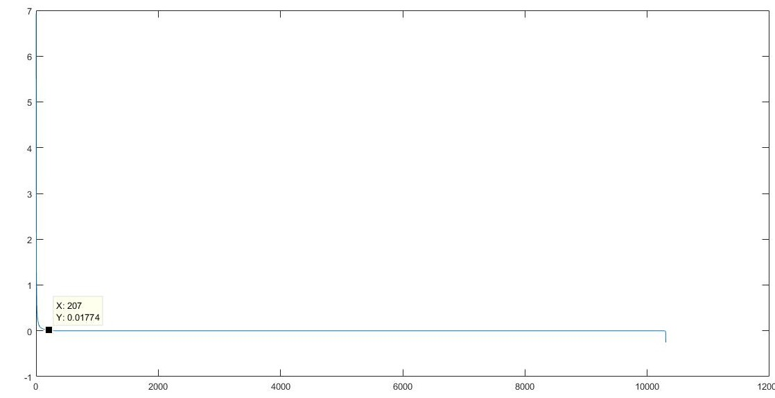
Eigenface change
In this section, we fix the training and test data (7 to 3) and then change the images to three values of 25, 400 and 6400, and check the result for all three algorithms.
Eigenvalue chart
 |  | SVM | KNN | LDA
Eigenface Size | 5*5 | 80.25% | 77.60% | 66.5%
 | 20*20 | 93.5% | 90.40% | 92.75%
 | 80*80 | 93.65% | 85.55% | 94.6%
 |  | SVM | KNN | LDA
Eigenface Size | 5*5 | 86.67% | 95.8% | 64.2
 | 20*20 | 90% | 90% | 90.23
 | 80*80 | 90% | 95% | 92.5%

Slide 11
Conclusion
According to the results in the training data change section, it is clear that increasing the training data increases the accuracy of the decision, on the other hand, with increasing it, the most time also increases. Reduces Leza From the three categories mentioned, allocating 70% of the data to training data is the best option.
In the image reduction section, we saw that the excessive increase in the size of the auxiliary images is not carefully classified and does not necessarily contain more useful information, and increases the calculations and time because, as seen in the special values diagram, from one point to The eigenvalues are severely reduced, the features are redundant and noisy, and sometimes have the opposite effect as a result of the classification.

Slide 12
Conclusion
In classification algorithms, KNN has a relatively better accuracy in terms of classification accuracy. Also, due to the simplicity of calculations, this algorithm takes less time. SVM is better than LDA in terms of accuracy but takes longer due to the need to train 780 binary classifiers.

